Slide 1
DEPARTMENT OF ELECTRICAL AND ELECTRONICS
ENGINEERING
18EEP301L-MINOR PROJECT-III
FIRST REVIEW
SOIL HEALTH MONITORING AND AUTOMATED CROP DISEASE DETECTION SYSTEM
YEAR/ SEMESTER – III/V
BATCH NUMBER : 03
DATE : 20.09.2024
GUIDED BY:
Dr.K.SUNDARARAJU PROFESSOR/EEE
PRESENTED BY: BOOMIKA V (927622BEE013)
DEEPAN R (927622BEE017)
HARIPRABHU SM (927622BEE038)

Slide 2
LIST OF CONTENTS
Abstract
Objective
Existing System
Proposed Solution
Block Diagram
Components used
Components Description
Literature Review
Working Explanation
Future Work
References

Slide 3
ABSTRACT
The "Soil Health Monitoring and Automated Crop Disease Detection System" helps farmers improve crop yields by tracking soil conditions like moisture, temperature, and pH with sensors.
Additionally, it uses image processing to detect early signs of crop diseases, enabling quick interventions to prevent further damage. This system helps to reduce crop losses, supports efficient resource use, and promotes sustainable farming.

Slide 4
OBJECTIVE
Enhance overall crop productivity and quality by preventing diseases and maintaining optimal soil conditions.
This system aims to incorporate advanced technology to detect and diagnose crop diseases early.
This system provide real-time updates and alerts to farmers regarding both soil health and crop conditions.

Slide 5
EXISTING SYSYTEM
This system monitor various soil parameters like moisture, temperature, and nutrient levels, and detect diseases using image recognition technology. The information is then analyzed to provide farmers with real-time updates and recommendations for improving crop health.

Slide 6
PROPOSED SOLUTION
The "Soil Health Monitoring and Automated Crop Disease Detection System" uses sensors to check soil conditions and provide recommendations for better soil management. It also uses cameras to spot early signs of crop diseases, helping farmers address issues quickly and improve crop yield.

Slide 7
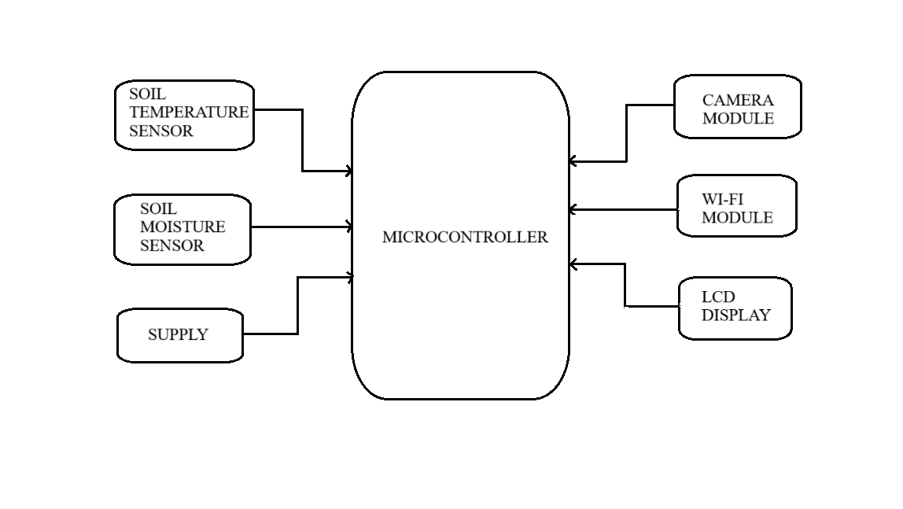
BLOCK DIAGRAM

Slide 8
COMPONENTS USED
Soil Moisture Sensor
Soil Temperature Sensor
Camera Module
Microcontroller
Wireless Communication Module

Slide 9
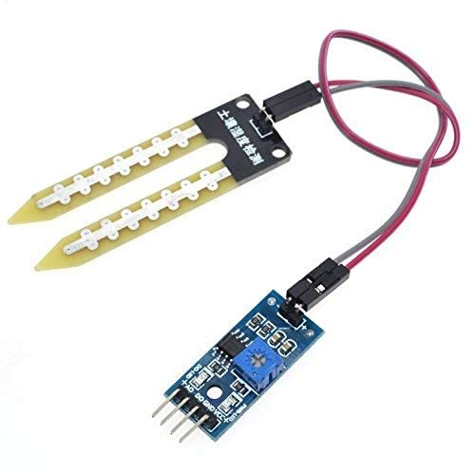
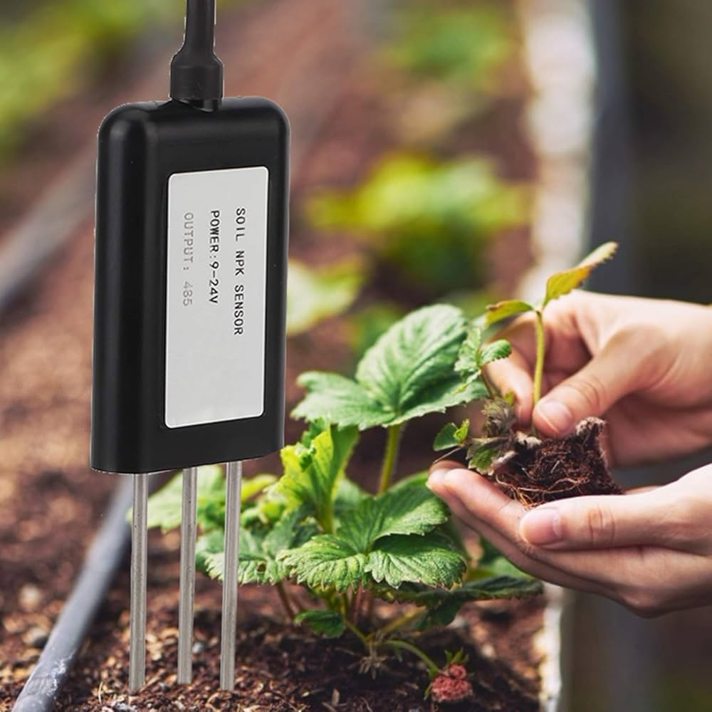
COMPONENTS DESCRIPTION
Soil Moisture Sensor
A soil moisture sensor helps maintain soil health by monitoring water levels, preventing overwatering or drought. It supports automated systems for efficient irrigation and early crop disease detection.
Soil Temperature Sensor
Soil temperature sensors measure soil warmth, helping monitor optimal conditions for plant growth and detect issues that might indicate disease, supporting timely interventions.

Slide 10
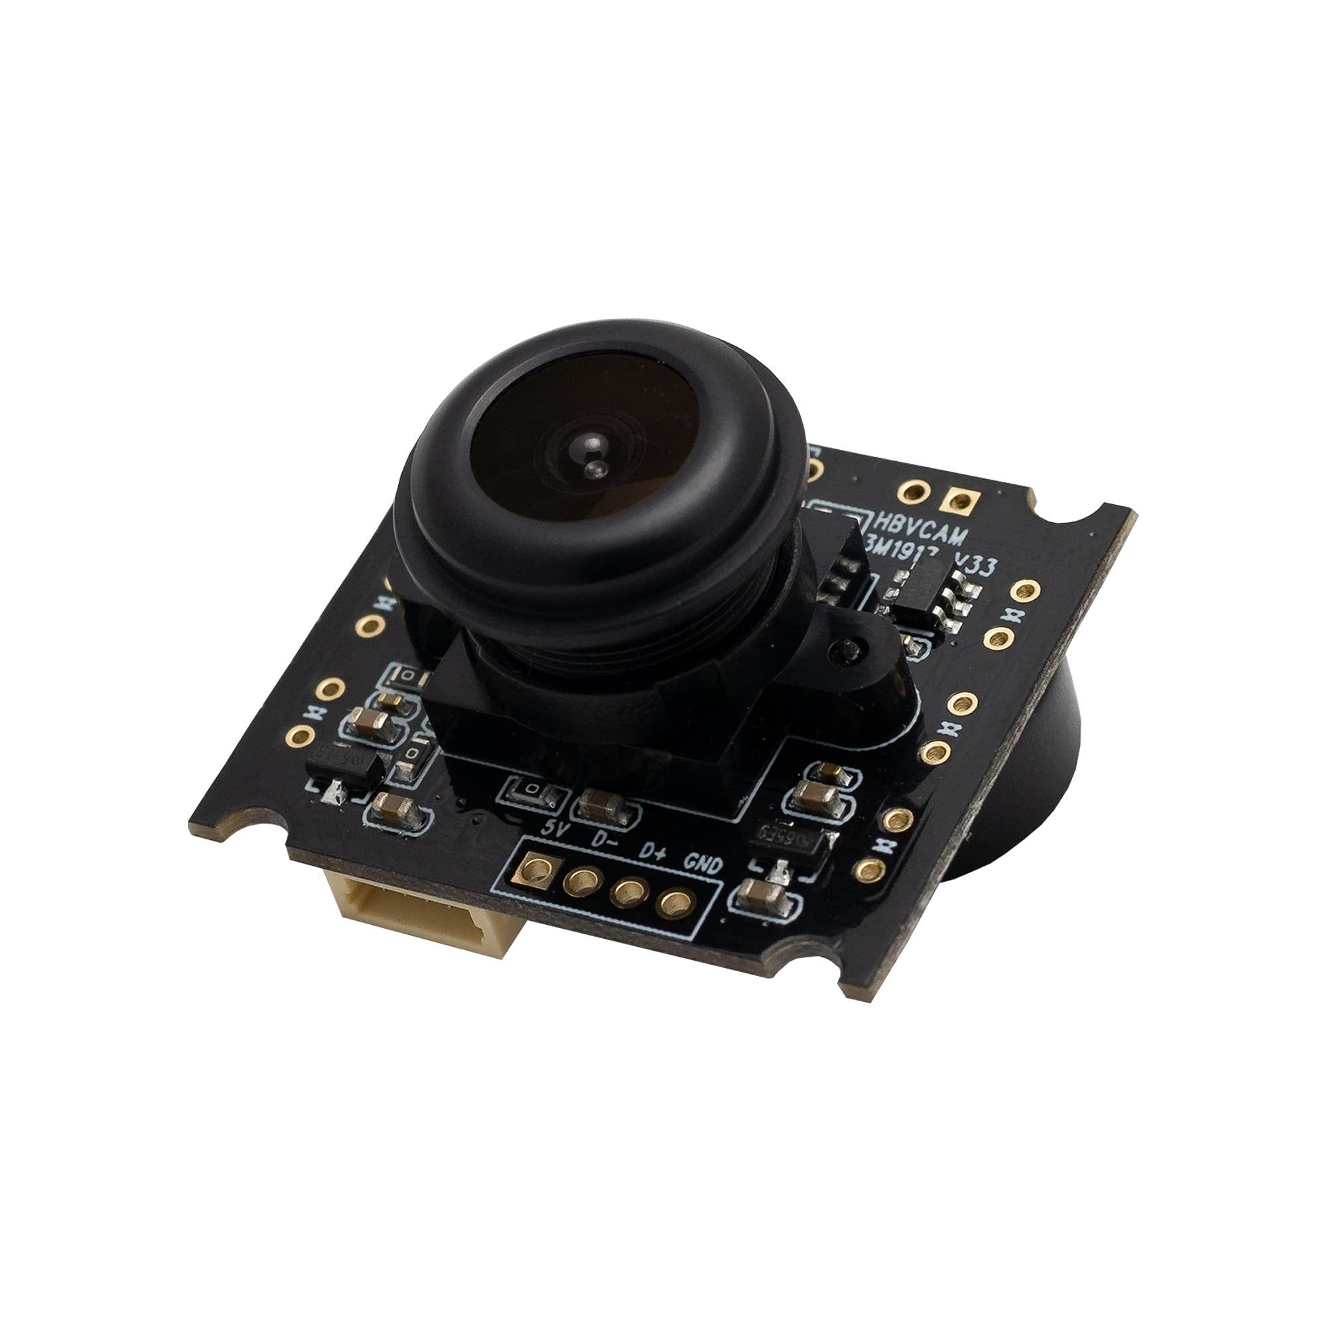
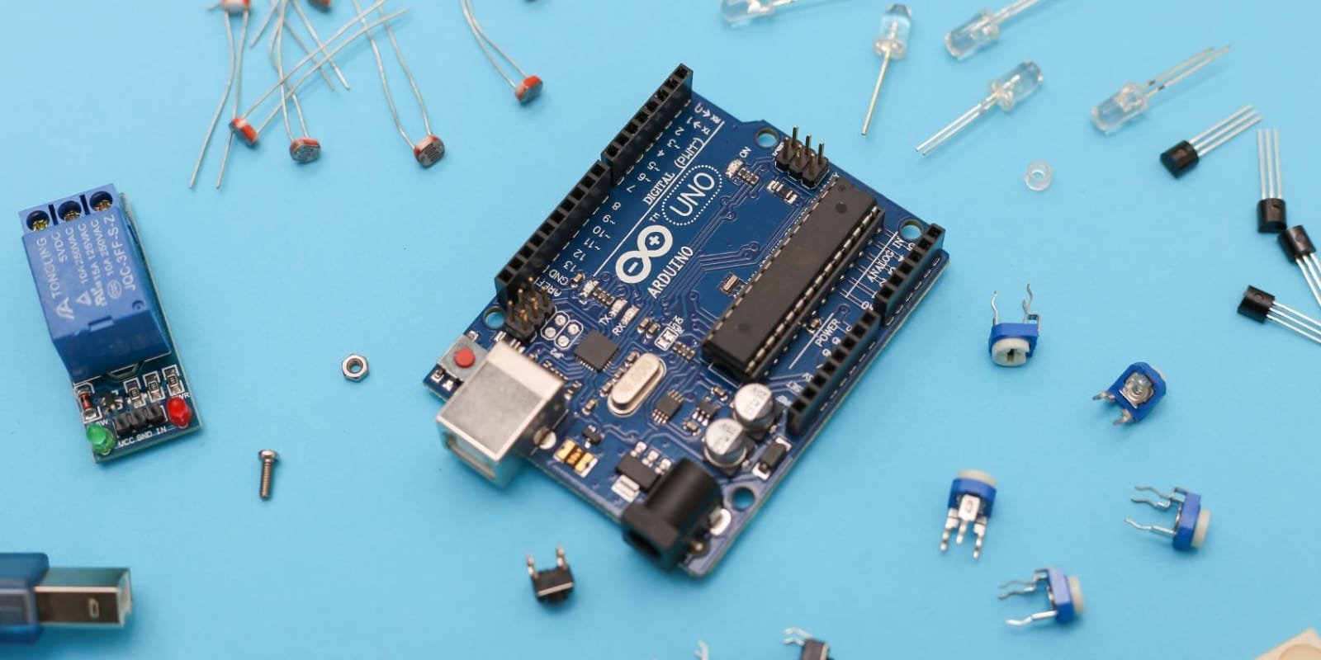
Camera Module
A camera module in soil health monitoring captures images to assess soil color, texture, and signs of erosion or nutrient deficiency. It helps to identify early symptoms of plant diseases, such as discoloration or leaf spots, enabling timely action and improved crop management.
Microcontroller
A microcontroller controls sensors in soil health monitoring, processing data to automate irrigation. It also manages cameras and algorithms in crop disease detection to identify issues early.

Slide 11
LITERATURE REVIEW
Peddi (2022) suggests the use of open data platform, namely Adafruit IO, for visualizing and analyzing real-time in the IOT integrated system. It provides the information between the planting phase and harvesting phase to facilitate soil management.
Shreekant Gorpade (2023) examines the design and development of an IOT device with integrated machine learning capabilities for continuously monitoring soil moisture, humidity and temperature levels.

Slide 12
WORKING EXPLANATION
This system works together to improve farming efficiency. A camera module, connected to a microcontroller, capture images of the crops to detect diseases. Sensors such as temperature, moisture, pH, and nutrient sensors continuously monitor the soil's condition. The microcontroller processes data from these sensors, providing real-time information about the soil’s temperature, moisture levels, acidity (pH), and nutrient content. By analyzing this data, the system can detect unhealthy soil conditions that might affect crop growth, while the camera helps identify visible signs of diseases, allowing farmers to take timely action for healthier crops.

Slide 13
FUTURE WORK
This can be integrated by using sensors and a camera module. The microcontroller processes data from temperature, moisture, pH, and nutrient sensors to assess soil conditions. The camera tracks plant health for signs of disease. This combined system enables early detection of both soil issues and crop diseases. Real-time data helps farmers take timely action, improving crop yield. This approach ensures efficient, sustainable farming.

Slide 14
REFERENCES
1.) Prakash M. Mainkar, Shreekant Ghorpade and Mayur Adawadkar "Plant Leaf Disease Detection and Classification Using Image Processing Techniques" International Journal of Innovative and Emerging Research in Engineering Volume 2, Issue 4, 2023.
2.) P. Peddi, A. Dasgupta and V. H. Gaidhane, "Smart Irrigation Systems: Soil Monitoring and Disease Detection for Precision Agriculture," 2022 IEEE International IOT, Electronics and Mechatronics Conference (IEMTRONICS), Toronto, ON, Canada, 2022, pp.1-7,IEMTRONICS55184,2022.

Slide 15


